Slide 1

ORRERY WEB APP BY TEAM VAMK’D

Slide 2
Orrery Web app challenge
About us
Concept Overview
Information Section Overview
Orrery Web App Overview
Game Overview

Slide 3
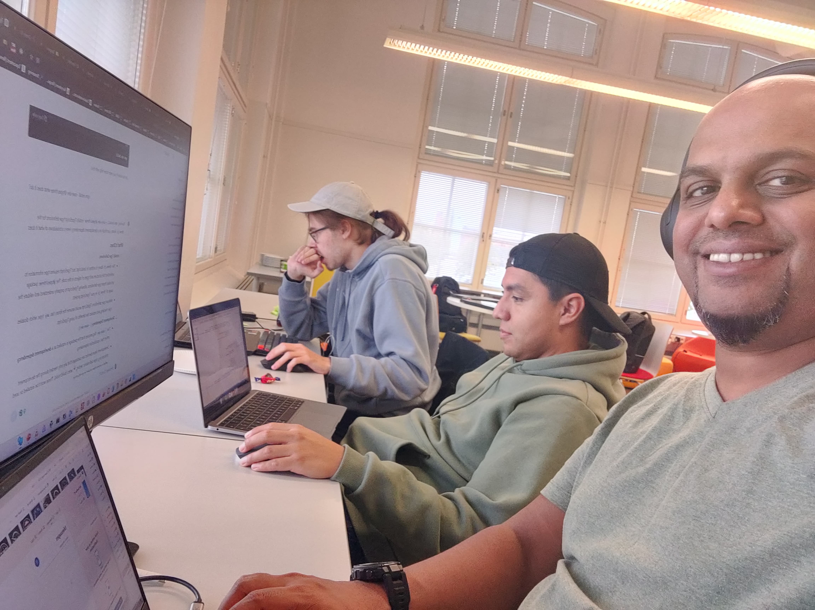
About us
We are a group of recently graduated IT Students from different parts of the world studying at VAMK in Vaasa, Finland. Our passion for programming brought us together to attempt this challenge. We wanted to make an impact as well as challenge ourselves with using new technologies and a time crunch.

Slide 4
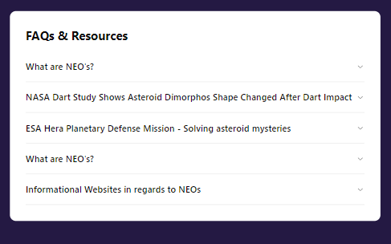
Information section overview
Information and FAQ’s of NEOs
Content from other providers like NASA ESA etc
Interesting tit-bits of information
User-friendly learning
Retrieval Augmented Generated AI Chatbot using open-source tools like DiFy or Flowise

Slide 5
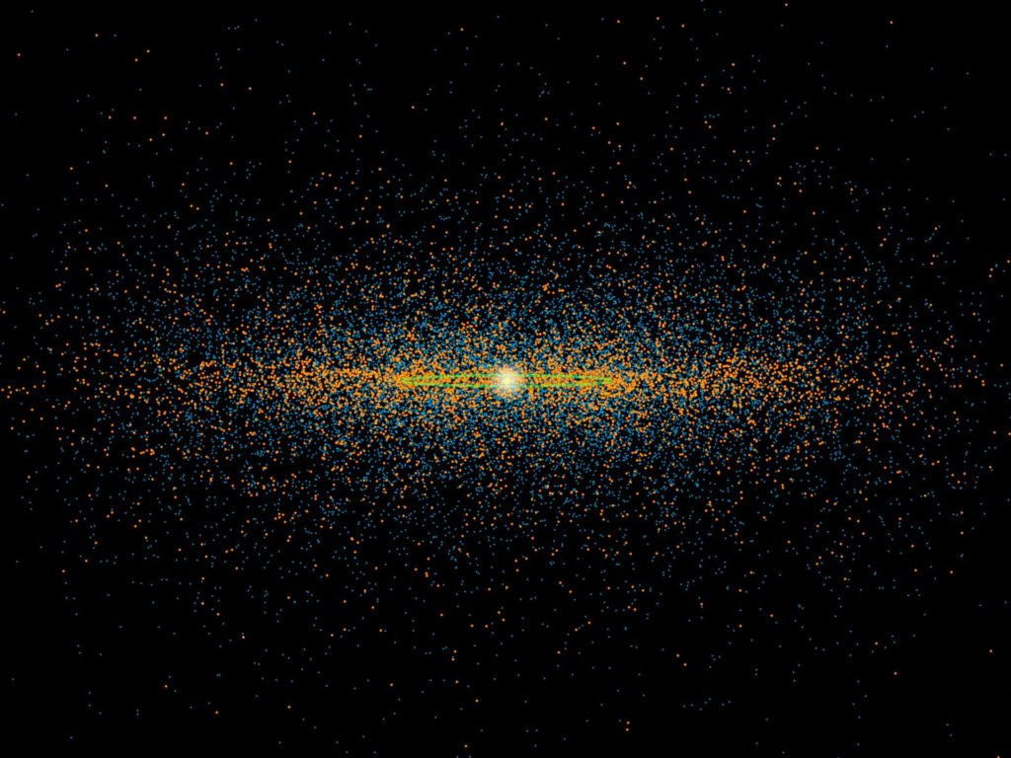
Orrery web app overview
Orrery model with ability to filter object types
Wallpaper saving option
Free-Roam of Solar System
Object details available
Time linked view based on NASA NEO API
Responsive design for all devices

Slide 6
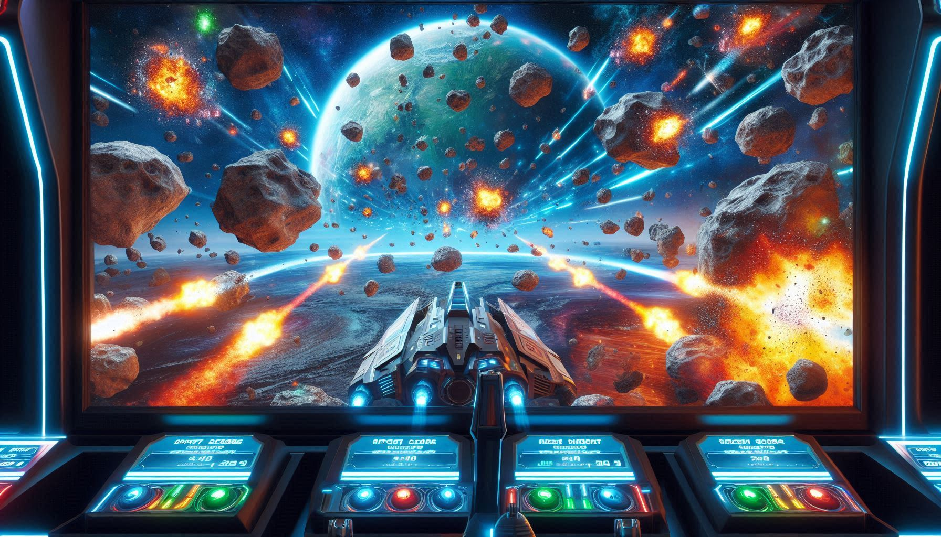
Game Overview
Gamification of the Orrery app
Educational, Strategy, Simulation combined
Campaign, Sandbox, Multiplayer gameplay
For All Age Groups, For All Skill Levels
Free-Form flight to explore the system

Slide 7
thank you
https://spaceapps.server.kunalmenon.com/
https://github.com/K-M-Code/NASASpaceApps2024/
Team VAMK’d
NASA SPACE APPS 2024

